Slide 1
INHERITANCE
Prabhjot Kaur
Department of Computer Science and Engineering
Chitkara University, Punjab
1
Notes:
1

Slide 2
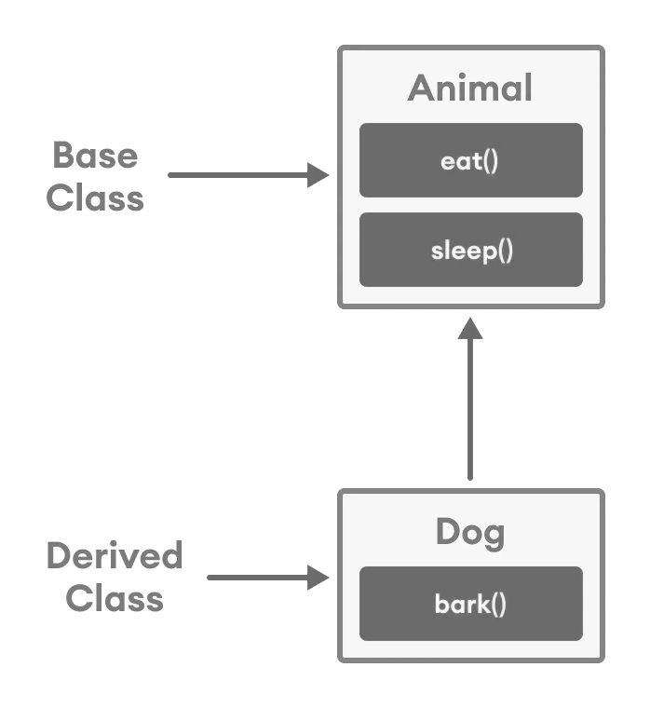
Introduction to Inheritance
Inheritance is one of the key features of Object-oriented programming in C++. It allows us to create a new class (derived class/Child Class) from an existing class (base class/Parent Class).
The derived class inherits the features from the base class and can have additional features of its own. For Ex:
class Animal
{
// eat() function
// sleep() function
};
class Dog : public Animal
{
// bark() function
};

Slide 3
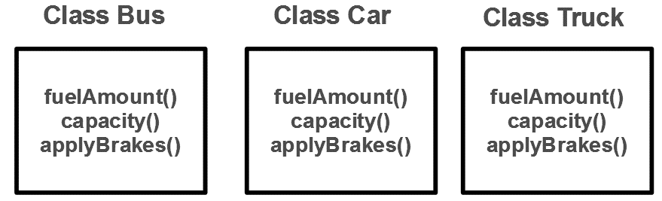
Why and when to use inheritance?
Consider a group of vehicles. You need to create classes for Bus, Car and Truck. The methods fuelAmount(), capacity(), applyBrakes() will be same for all of the three classes.
If we create these classes avoiding inheritance then we have to write all of these functions in each of the three classes as shown in below figure:

Slide 4
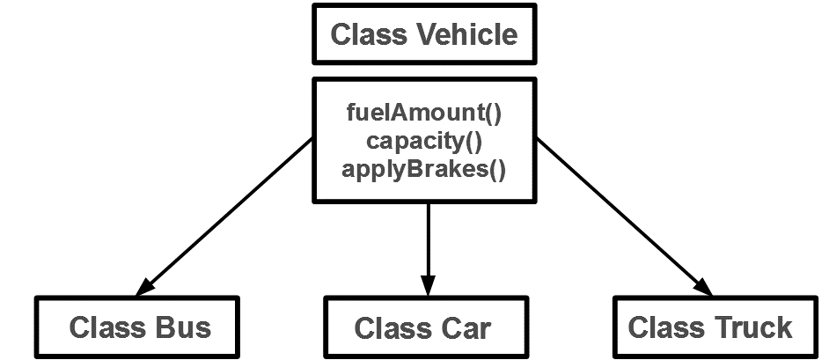
Why and when to use inheritance? (Contd.)
The above process results in duplication of same code 3 times. This increases the chances of error and data redundancy. To avoid this type of situation, inheritance is used.
If we create a class Vehicle and write these three functions in it and inherit the rest of the classes from the vehicle class, then we can simply avoid the duplication of data and increase re-usability.
So, the below diagram in which the three classes are inherited from vehicle class:

Slide 5
Implementing Inheritance in C++
For creating a sub-class which is inherited from the base class we have syntax:
Syntax:
class subclass_name/child class : access_mode base_class_name/parent class
{
// body of subclass
};
Here, subclass_name is the name of the sub class, access_mode is the mode in which you want to inherit this sub class for example: public, private etc. and base_class_name is the name of the base class from which you want to inherit the sub class.
Note: A derived class doesn’t inherit access to private data members. However, it does inherit a full parent object, which contains any private members which that class declares.

Slide 6
C++ program to demonstrate implementation of Inheritance
#include <iostream.h>
Using namespace std;
// Base class
class Parent
{
public:
int id_p;
};
// Sub class inheriting from Base Class(Parent)
class Child : public Parent
{
public:
int id_c;
};
int main()
{
Child obj1;
// An object of class child has all data members
// and member functions of class parent
obj1.id_c = 7;
obj1.id_p = 91;
cout << "Child id is: " << obj1.id_c << '\n';
cout << "Parent id is: " << obj1.id_p << '\n';
return 0;
}
Output
Child id is 7
Parent id is 91

Slide 7
Modes of Inheritance
Public mode: If we derive a sub class from a public base class. Then the public member of the base class will become public in the derived class and protected members of the base class will become protected in derived class.
Protected mode: If we derive a sub class from a Protected base class. Then both public member and protected members of the base class will become protected in derived class.
Private mode: If we derive a sub class from a Private base class. Then both public member and protected members of the base class will become Private in derived class.
Note: The private members in the base class cannot be directly accessed in the derived class, while protected members can be directly accessed.

Slide 8
Forms of Inheritance
1. Single Inheritance: In single inheritance, a class is allowed to inherit from only one class. i.e. one sub class is inherited by one base class only.
Syntax:
class subclass_name : access_mode base_class { // body of subclass };
#include<iostream>
using namespace std;
// base class
class Vehicle {
public:
Vehicle()
{
cout << "This is a Vehicle\n";
}
};
// sub class derived from a single base classes
class Car : public Vehicle {
};
int main()
{
// Creating object of sub class will
// invoke the constructor of base classes
Car obj;
return 0;
}
Output
This is a Vehicle

Slide 9
Forms of Inheritance
2. Multiple Inheritance: Multiple Inheritance is a feature of C++ where a class can inherit from more than one classes. i.e one sub class is inherited from more than one base classes.
Syntax:
class subclass_name : access_mode base_class1, access_mode base_class2, ....
{
// body of subclass
};
class Car : public Vehicle, public FourWheeler {
};
// main function
int main()
{
// Creating object of sub class will
// invoke the constructor of base classes.
Car obj;
return 0;
}
#include<iostream>
using namespace std;
class Vehicle {
public:
Vehicle()
{
cout << "This is a Vehicle\n";
}
};
class FourWheeler {
public:
FourWheeler()
{
cout << "This is a 4 wheeler Vehicle\n";
}};
Output
This is a Vehicle
This is a 4 wheeler Vehicle

Slide 10
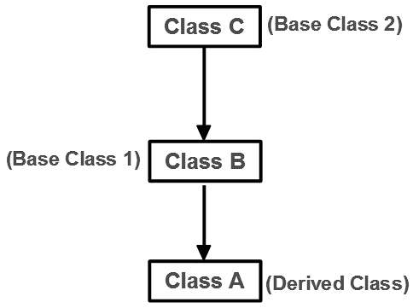
Forms of Inheritance
3. Multilevel Inheritance: In this type of inheritance, a derived class is created from another derived class.

Slide 11
Multilevel Inheritance:
#include<iostream>
using namespace std;
// base class
class Vehicle
{
public:
Vehicle()
{
cout << "This is a Vehicle\n";
}
};
// first sub_class derived from class vehicle
class fourWheeler: public Vehicle
{ public:
fourWheeler()
{
cout << "Objects with 4 wheels are vehicles\n";
}
};
// sub class derived from the derived base class fourWheeler
class Car: public fourWheeler {
public:
Car()
{
cout << "Car has 4 Wheels\n";
}};
int main()
{
// Creating object of sub class will
// invoke the constructor of base classes.
Car obj;
return 0;
}
Output
This is a Vehicle
Objects with 4 wheels are vehicles
Car has 4 Wheels

Slide 12
Forms Of Inheritance
4. Hierarchical Inheritance: In this type of inheritance, more than one sub class is inherited from a single base class. i.e. more than one derived class is created from a single base class.
#include<iostream>
using namespace std;
// base class
class Vehicle
{
public:
Vehicle()
{
cout << "This is a Vehicle\n";
}
};
// first sub class
class Car: public Vehicle
{
};
int main()
{
// Creating object of sub class will
// invoke the constructor of base class.
Car obj1;
Bus obj2;
return 0;
}
Output
This is a Vehicle
This is a Vehicle

Slide 13
Forms Of Inheritance
5. Hybrid (Virtual) Inheritance: Hybrid Inheritance is implemented by combining more than one type of inheritance. For example: Combining Hierarchical inheritance and Multiple Inheritance.
#include<iostream>
using namespace std;
class Vehicle
{
public:
Vehicle()
{
cout << "This is a Vehicle\n";
}
};
class Fare
{
public:
Fare()
{
cout << "Fare of Vehicle\n";
}};
// first sub class
class Car : public Vehicle
{
};
// second sub class
class Bus : public Vehicle, public Fare
{
};
int main()
{
// Creating object of sub class will
// invoke the constructor of base class.
Bus obj2;
return 0;
}
Output
This is a Vehicle
Fare of Vehicle

Slide 14
Ambiguity Resolution in Inheritance
Ambiguity in inheritance can be defined as when one class is derived for two or more base classes then there are chances that the base classes have functions with the same name. So it will confuse derived class to choose from similar name functions. To solve this ambiguity scope resolution operator is used “::”.
#include<iostream>
using namespace std;
// Base class A
class A {
public:
void func() {
cout << " I am in class A" << endl;
}
};
class B {// Base class B
public:
void func() {
cout << " I am in class B" << endl; }
};
class C: public A, public B {
};
int main() {
// Created an object of class C
C obj;
// Calling function func()
obj.func();
return 0;
}
OUTPUT WILL BE ERROR SO SOLUTION IS SCOPE RESOLUTION OPERATOR

Slide 15
Ambiguity Resolution in Inheritance
#include<iostream>
using namespace std;
// Base class A
class A {
public:
void func() {
cout << " I am in class A" << endl;
}
};
// Base class B
class B {
public:
void func() {
cout << " I am in class B" << endl;
}
};
class C: public A, public B {
};
// Driver Code
int main() {
// Created an object of class C
C obj;
// Calling function func() in class A
obj.A::func();
// Calling function func() in class B
obj.B::func();
return 0;
}
Output:
I am in class A
I am in class B

Slide 16
Inheritance with Constructor
Base class Default Constructor in Derived class Constructors:
When we derive a class from the base class then all the data members of the base class will become a member of the derived class.
We use the constructor to initialize the data members
When the data is inherited into the derived class we need to initialize it: To initialize the inherited data members constructor is necessary and that's why the constructor of the base class is called first.

Slide 17
Example: Base class Default Constructor in Derived class Constructors:
#include <iostream>
using namespace std;
class Base
{
int x;
public:
Base()
{
cout << "Base default constructor\n";
}
};
class Derived : public Base
{
int y;
public:
// default constructor
Derived()
{
cout << "Derived default constructor\n";
}
// parameterized constructor
Derived(int i)
{
cout << "Derived parameterized constructor\n";
}
};
int main()
{
Base b;
Derived d1;
Derived d2(10);
}
Output:
Base default constructor
Base default constructor
Derived default constructor
Base default constructor
Derived parameterized constructor

Slide 18
Example 2: Base class Parameterized Constructor in Derived class Constructor
#include <iostream>
using namespace std;
class Base
{
int x;
public:
// parameterized constructor
Base(int i)
{
x = i;
cout << "Base Parameterized Constructor\n";
}
};
class Derived: public Base
{
int y;
public:
// parameterized constructor
Derived(int j):Base(j)
{
y = j;
cout << "Derived Parameterized Constructor\n";
}
};
int main()
{
Derived d(10) ;
}
Output:
Base Parameterized Constructor
Derived Parameterized Constructor

Slide 19
Order of Constructor/ Destructor Call in C++
Whenever we create an object of a class, the default constructor of that class is invoked automatically to initialize the members of the class.
If we inherit a class from another class and create an object of the derived class, it is clear that the default constructor of the derived class will be invoked but before that the default constructor of all of the base classes will be invoke, i.e the order of invocation is that the base class’s default constructor will be invoked first and then the derived class’s default constructor will be invoked.

Slide 20
Basic rules for the Order of Constructor Call with Inheritance
Construction always starts with the base class. If there are multiple base classes then, construction starts with the leftmost base. If there is a virtual inheritance then it's given higher preference.
Then the member fields are constructed. They are initialized in the order they are declared.
Finally, the class itself is constructed.
The order of the destructor is exactly the reverse.

Slide 21
Order of Constructor/ Destructor Call in C++
Example: Program to show the order of constructor call in single inheritance
#include <iostream>
using namespace std;
class Parent
{
public:
Parent()
{
cout << "Inside base class" << endl;
}
};
class Child : public Parent
{
public:
Child()
{
cout << "Inside sub class" << endl;
}
};
// main function
int main() {
// creating object of sub class
Child obj;
return 0;
}

Slide 22
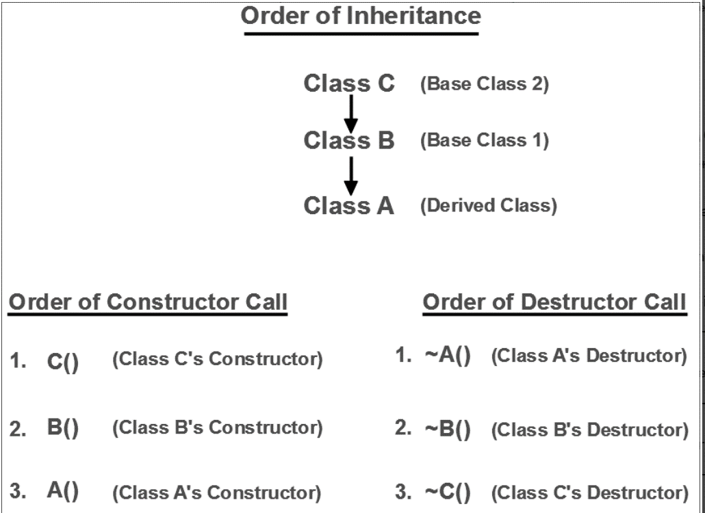
Order of Inheritance

Slide 23
Function Overriding
Inheritance is a feature of OOP that allows us to create derived classes from a base class.
The derived classes inherit features of the base class.
If the same function is defined in both the derived class and the based class. If we call this function using the object of the derived class, the function of the derived class is executed. This is known as function overriding in C++.
The function in derived class overrides the function in base class.

Slide 24
Function Overriding
#include <iostream>
using namespace std;
class Base {
public:
void print() {
cout << "Base Function" << endl;
}
};
class Derived : public Base {
public:
void print() {
cout << "Derived Function" << endl;
}
};
int main() {
Derived derived1;
derived1.print();
return 0;
}
Output
Derived Function

Slide 25
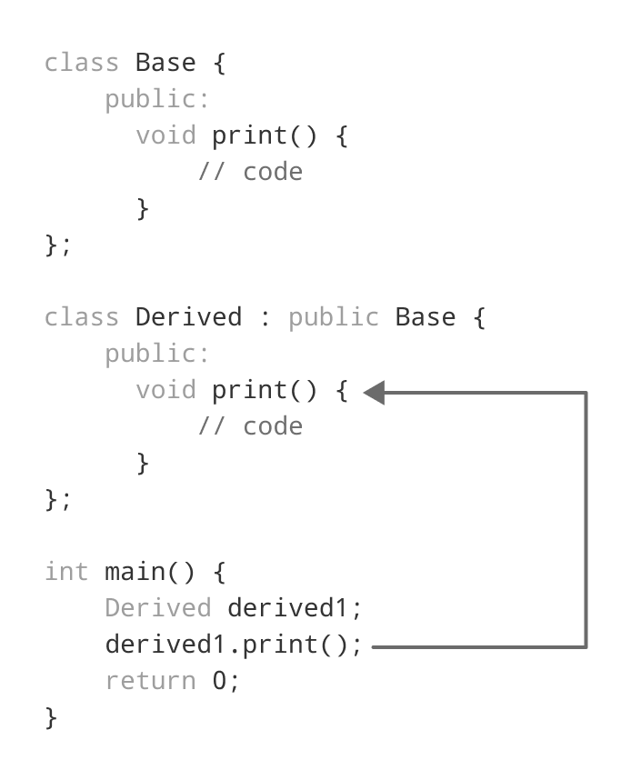
Working of Function Overriding in C++

Slide 26
Thank You

